Slide 1
Day | Weather | Temperature | Humidity | Wind | Play Football?
1 | Sunny | Hot | High | Weak | No
2 | Sunny | Hot | High | Strong | No
3 | Cloudy | Hot | High | Weak | Yes
4 | Rain | Mild | High | Weak | Yes
5 | Rain | Cold | Normal | Weak | Yes
6 | Rain | Cold | Normal | Strong | No
7 | Cloudy | Cold | Normal | Strong | Yes
8 | Sunny | Mild | High | Weak | No
9 | Sunny | Cold | Normal | Weak | Yes
10 | Rain | Mild | Normal | Weak | Yes
11 | Sunny | Mild | Normal | Strong | Yes
12 | Cloudy | Mild | High | Strong | Yes
13 | Cloudy | Hot | Normal | Weak | Yes
14 | Rain | Mild | High | Strong | No

Slide 2
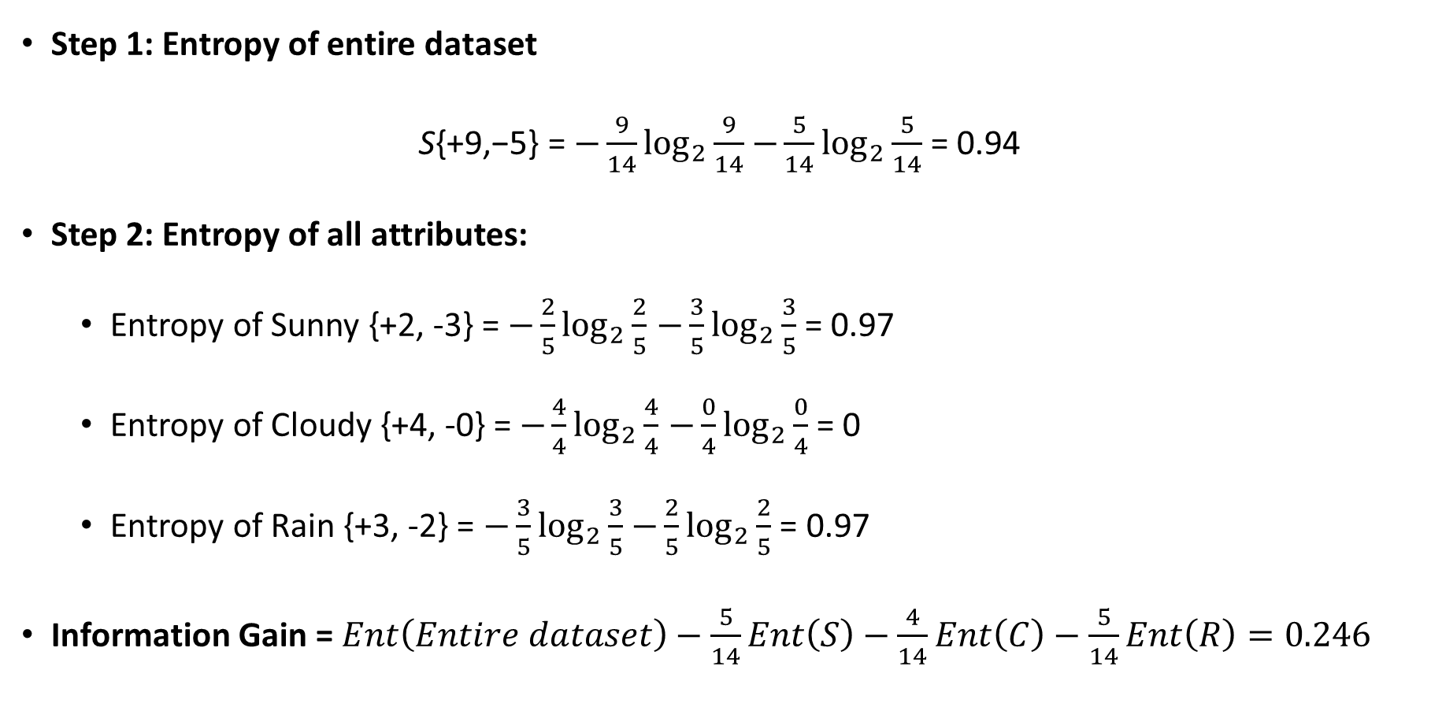
Calculate Information gain of Weather
Step 1: Entropy of entire dataset
S{+9,−5} = $−\frac{9}{14}\log_{2}{\frac{9}{14}}$ $−\frac{5}{14}\log_{2}{\frac{5}{14}}$ = 0.94
Step 2: Entropy of all attributes:
Entropy of Sunny {+2, -3} = $−\frac{2}{5}\log_{2}{\frac{2}{5}}$ $−\frac{3}{5}\log_{2}{\frac{3}{5}}$ = 0.97
Entropy of Cloudy {+4, -0} = $−\frac{4}{4}\log_{2}{\frac{4}{4}}$ $−\frac{0}{4}\log_{2}{\frac{0}{4}}$ = 0
Entropy of Rain {+3, -2} = $−\frac{3}{5}\log_{2}{\frac{3}{5}}$ $−\frac{2}{5}\log_{2}{\frac{2}{5}}$ = 0.97
Information Gain = $Ent\left(Entire dataset\right)−\frac{5}{14}Ent\left(S\right)−\frac{4}{14}Ent\left(C\right)−\frac{5}{14}Ent\left(R\right)=0.246$

Slide 3
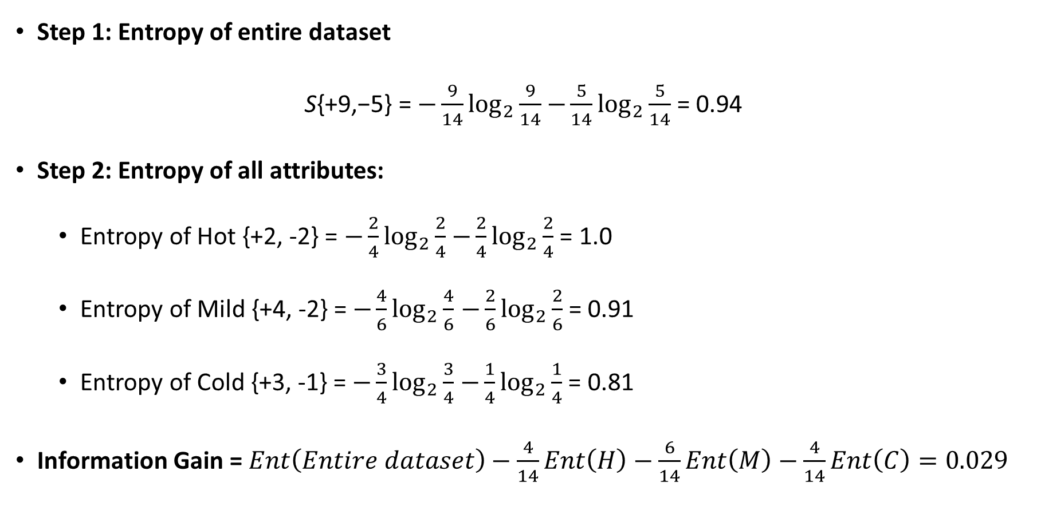
Calculate Information gain of Temperature
Step 1: Entropy of entire dataset
S{+9,−5} = $−\frac{9}{14}\log_{2}{\frac{9}{14}}$ $−\frac{5}{14}\log_{2}{\frac{5}{14}}$ = 0.94
Step 2: Entropy of all attributes:
Entropy of Hot {+2, -2} = $−\frac{2}{4}\log_{2}{\frac{2}{4}}$ $−\frac{2}{4}\log_{2}{\frac{2}{4}}$ = 1.0
Entropy of Mild {+4, -2} = $−\frac{4}{6}\log_{2}{\frac{4}{6}}$ $−\frac{2}{6}\log_{2}{\frac{2}{6}}$ = 0.91
Entropy of Cold {+3, -1} = $−\frac{3}{4}\log_{2}{\frac{3}{4}}$ $−\frac{1}{4}\log_{2}{\frac{1}{4}}$ = 0.81
Information Gain = $Ent\left(Entire dataset\right)−\frac{4}{14}Ent\left(H\right)−\frac{6}{14}Ent\left(M\right)−\frac{4}{14}Ent\left(C\right)=0.029$

Slide 4
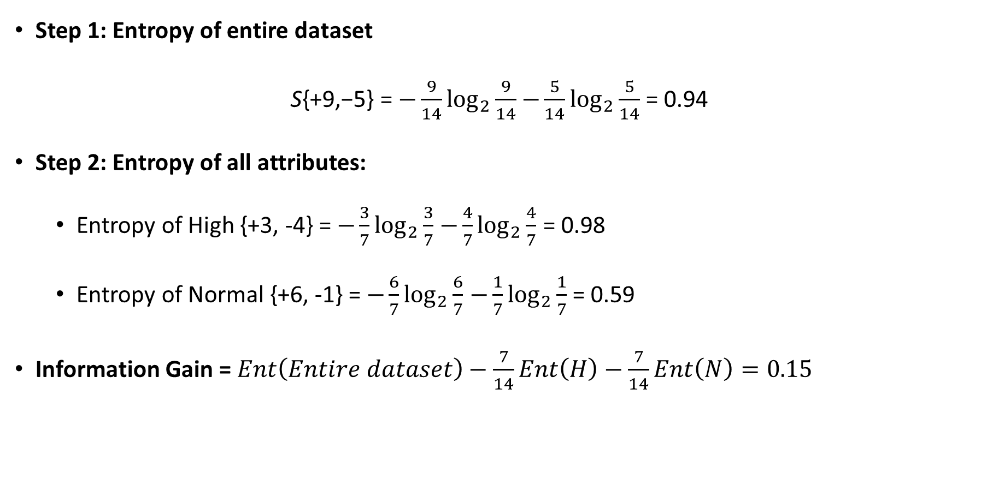
Calculate Information gain of Humidity
Step 1: Entropy of entire dataset
S{+9,−5} = $−\frac{9}{14}\log_{2}{\frac{9}{14}}$ $−\frac{5}{14}\log_{2}{\frac{5}{14}}$ = 0.94
Step 2: Entropy of all attributes:
Entropy of High {+3, -4} = $−\frac{3}{7}\log_{2}{\frac{3}{7}}$ $−\frac{4}{7}\log_{2}{\frac{4}{7}}$ = 0.98
Entropy of Normal {+6, -1} = $−\frac{6}{7}\log_{2}{\frac{6}{7}}$ $−\frac{1}{7}\log_{2}{\frac{1}{7}}$ = 0.59
Information Gain = $Ent\left(Entire dataset\right)−\frac{7}{14}Ent\left(H\right)−\frac{7}{14}Ent\left(N\right)=0.15$

Slide 5
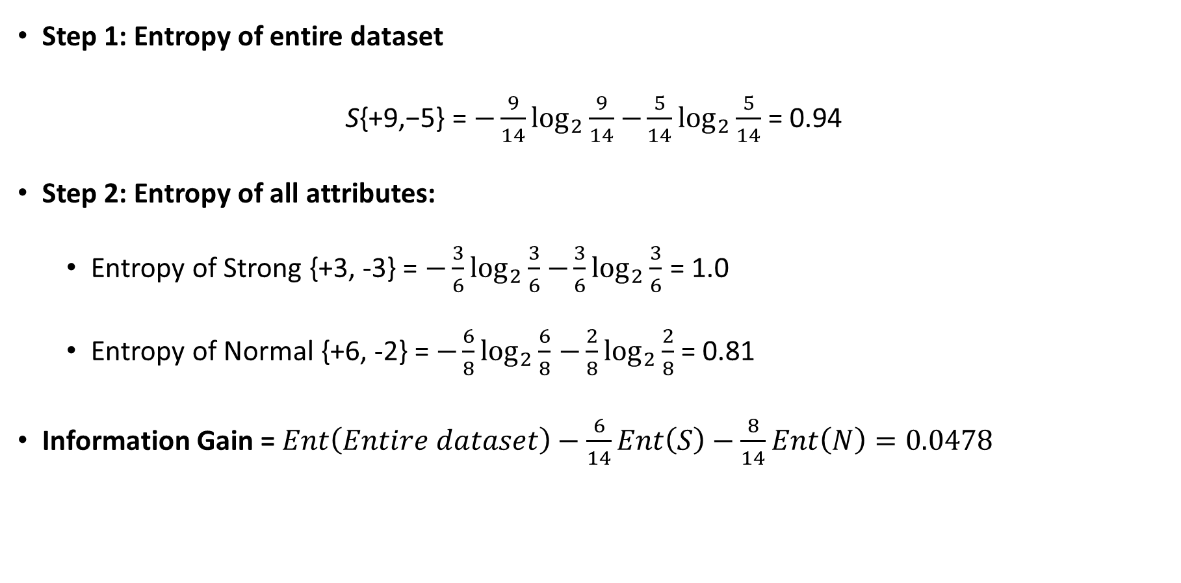
Calculate Information gain of Wind
Step 1: Entropy of entire dataset
S{+9,−5} = $−\frac{9}{14}\log_{2}{\frac{9}{14}}$ $−\frac{5}{14}\log_{2}{\frac{5}{14}}$ = 0.94
Step 2: Entropy of all attributes:
Entropy of Strong {+3, -3} = $−\frac{3}{6}\log_{2}{\frac{3}{6}}$ $−\frac{3}{6}\log_{2}{\frac{3}{6}}$ = 1.0
Entropy of Normal {+6, -2} = $−\frac{6}{8}\log_{2}{\frac{6}{8}}$ $−\frac{2}{8}\log_{2}{\frac{2}{8}}$ = 0.81
Information Gain = $Ent\left(Entire dataset\right)−\frac{6}{14}Ent\left(S\right)−\frac{8}{14}Ent\left(N\right)=0.0478$

Slide 6
Gain (S, Weather) = 0.246
Gain (S, Temp) = 0.029
Gain (S, Humidity) = 0.15
Gain (S, Wind) = 0.0478
Weather
Sunny
Cloudy
Rainy
YES

Slide 7
Weather | Temperature | Humidity | Wind | Play Football?
Sunny | Hot | High | Weak | No
Sunny | Hot | High | Strong | No
Sunny | Mild | High | Weak | No
Sunny | Cold | Normal | Weak | Yes
Sunny | Mild | Normal | Strong | Yes

Slide 8
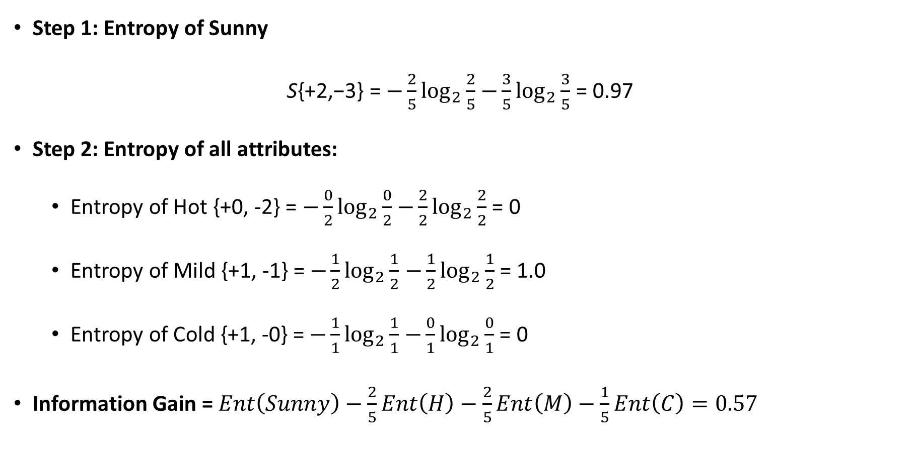
Calculate Information gain of Temperature
Step 1: Entropy of Sunny
S{+2,−3} = $−\frac{2}{5}\log_{2}{\frac{2}{5}}$ $−\frac{3}{5}\log_{2}{\frac{3}{5}}$ = 0.97
Step 2: Entropy of all attributes:
Entropy of Hot {+0, -2} = $−\frac{0}{2}\log_{2}{\frac{0}{2}}$ $−\frac{2}{2}\log_{2}{\frac{2}{2}}$ = 0
Entropy of Mild {+1, -1} = $−\frac{1}{2}\log_{2}{\frac{1}{2}}$ $−\frac{1}{2}\log_{2}{\frac{1}{2}}$ = 1.0
Entropy of Cold {+1, -0} = $−\frac{1}{1}\log_{2}{\frac{1}{1}}$ $−\frac{0}{1}\log_{2}{\frac{0}{1}}$ = 0
Information Gain = $Ent\left(Sunny\right)−\frac{2}{5}Ent\left(H\right)−\frac{2}{5}Ent\left(M\right)−\frac{1}{5}Ent\left(C\right)=0.57$

Slide 9
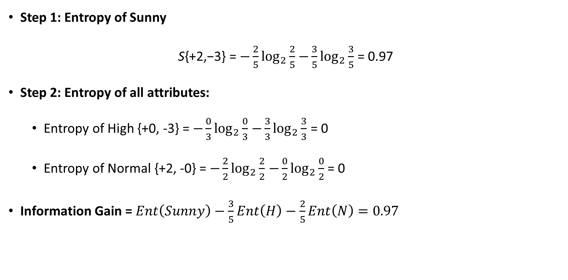
Calculate Information gain of Humidity
Step 1: Entropy of Sunny
S{+2,−3} = $−\frac{2}{5}\log_{2}{\frac{2}{5}}$ $−\frac{3}{5}\log_{2}{\frac{3}{5}}$ = 0.97
Step 2: Entropy of all attributes:
Entropy of High {+0, -3} = $−\frac{0}{3}\log_{2}{\frac{0}{3}}$ $−\frac{3}{3}\log_{2}{\frac{3}{3}}$ = 0
Entropy of Normal {+2, -0} = $−\frac{2}{2}\log_{2}{\frac{2}{2}}$ $−\frac{0}{2}\log_{2}{\frac{0}{2}}$ = 0
Information Gain = $Ent\left(Sunny\right)−\frac{3}{5}Ent\left(H\right)−\frac{2}{5}Ent\left(N\right)=0.97$

Slide 10
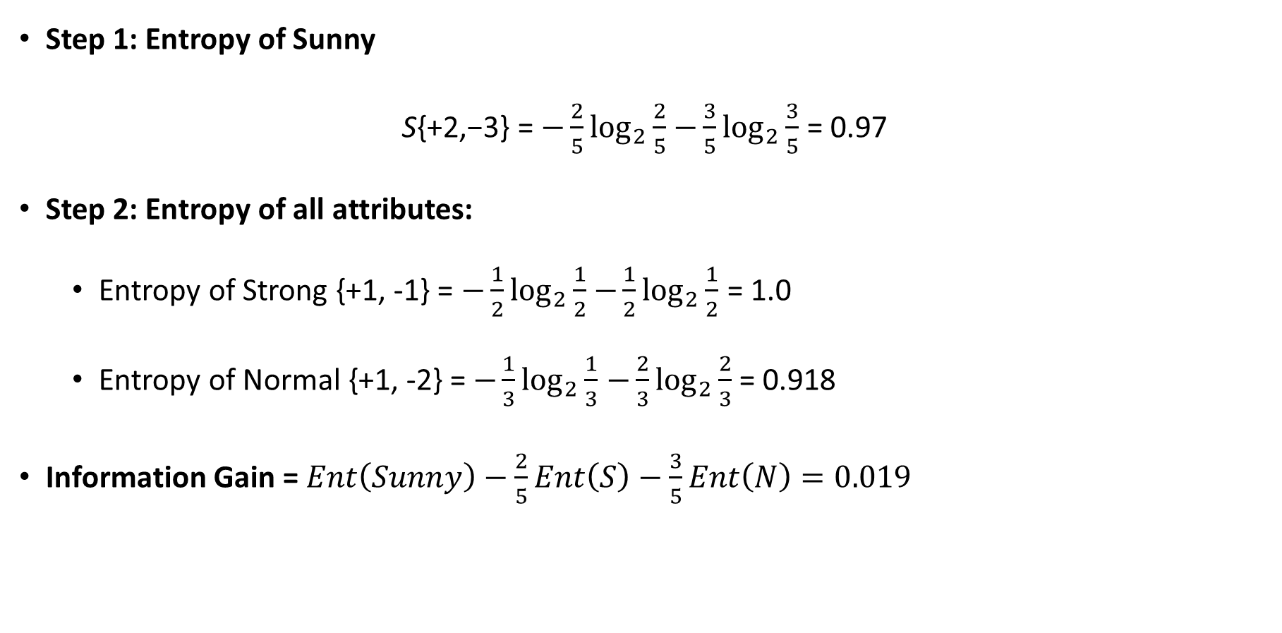
Calculate Information gain of Wind
Step 1: Entropy of Sunny
S{+2,−3} = $−\frac{2}{5}\log_{2}{\frac{2}{5}}$ $−\frac{3}{5}\log_{2}{\frac{3}{5}}$ = 0.97
Step 2: Entropy of all attributes:
Entropy of Strong {+1, -1} = $−\frac{1}{2}\log_{2}{\frac{1}{2}}$ $−\frac{1}{2}\log_{2}{\frac{1}{2}}$ = 1.0
Entropy of Normal {+1, -2} = $−\frac{1}{3}\log_{2}{\frac{1}{3}}$ $−\frac{2}{3}\log_{2}{\frac{2}{3}}$ = 0.918
Information Gain = $Ent\left(Sunny\right)−\frac{2}{5}Ent\left(S\right)−\frac{3}{5}Ent\left(N\right)=0.019$

Slide 11

Gain ($S_{sunny}$, Temp) = 0.57
Gain ($S_{sunny}$, Humidity) = 0.97
Gain ($S_{sunny}$, Wind) = 0.019
Weather
Sunny
Cloudy
Rainy
Humidity
YES
Normal
High
YES
NO

Slide 12
Weather | Temperature | Humidity | Wind | Play Football?
Rain | Mild | High | Weak | Yes
Rain | Cold | Normal | Weak | Yes
Rain | Cold | Normal | Strong | No
Rain | Mild | Normal | Weak | Yes
Rain | Mild | High | Strong | No

Slide 13
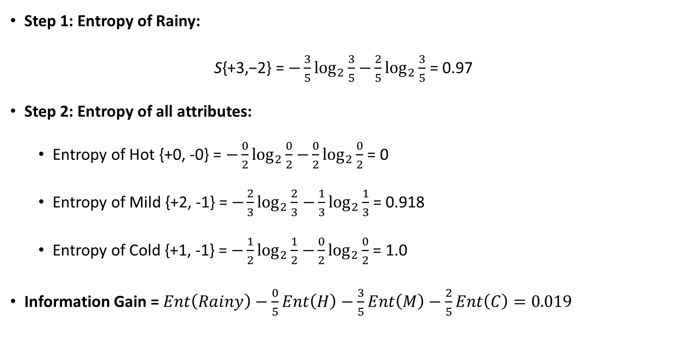
Calculate Information gain of Temperature
Step 1: Entropy of Rainy:
S{+3,−2} = $−\frac{3}{5}\log_{2}{\frac{3}{5}}$ $−\frac{2}{5}\log_{2}{\frac{3}{5}}$ = 0.97
Step 2: Entropy of all attributes:
Entropy of Hot {+0, -0} = $−\frac{0}{2}\log_{2}{\frac{0}{2}}$ $−\frac{0}{2}\log_{2}{\frac{0}{2}}$ = 0
Entropy of Mild {+2, -1} = $−\frac{2}{3}\log_{2}{\frac{2}{3}}$ $−\frac{1}{3}\log_{2}{\frac{1}{3}}$ = 0.918
Entropy of Cold {+1, -1} = $−\frac{1}{2}\log_{2}{\frac{1}{2}}$ $−\frac{0}{2}\log_{2}{\frac{0}{2}}$ = 1.0
Information Gain = $Ent\left(Rainy\right)−\frac{0}{5}Ent\left(H\right)−\frac{3}{5}Ent\left(M\right)−\frac{2}{5}Ent\left(C\right)=0.019$

Slide 14
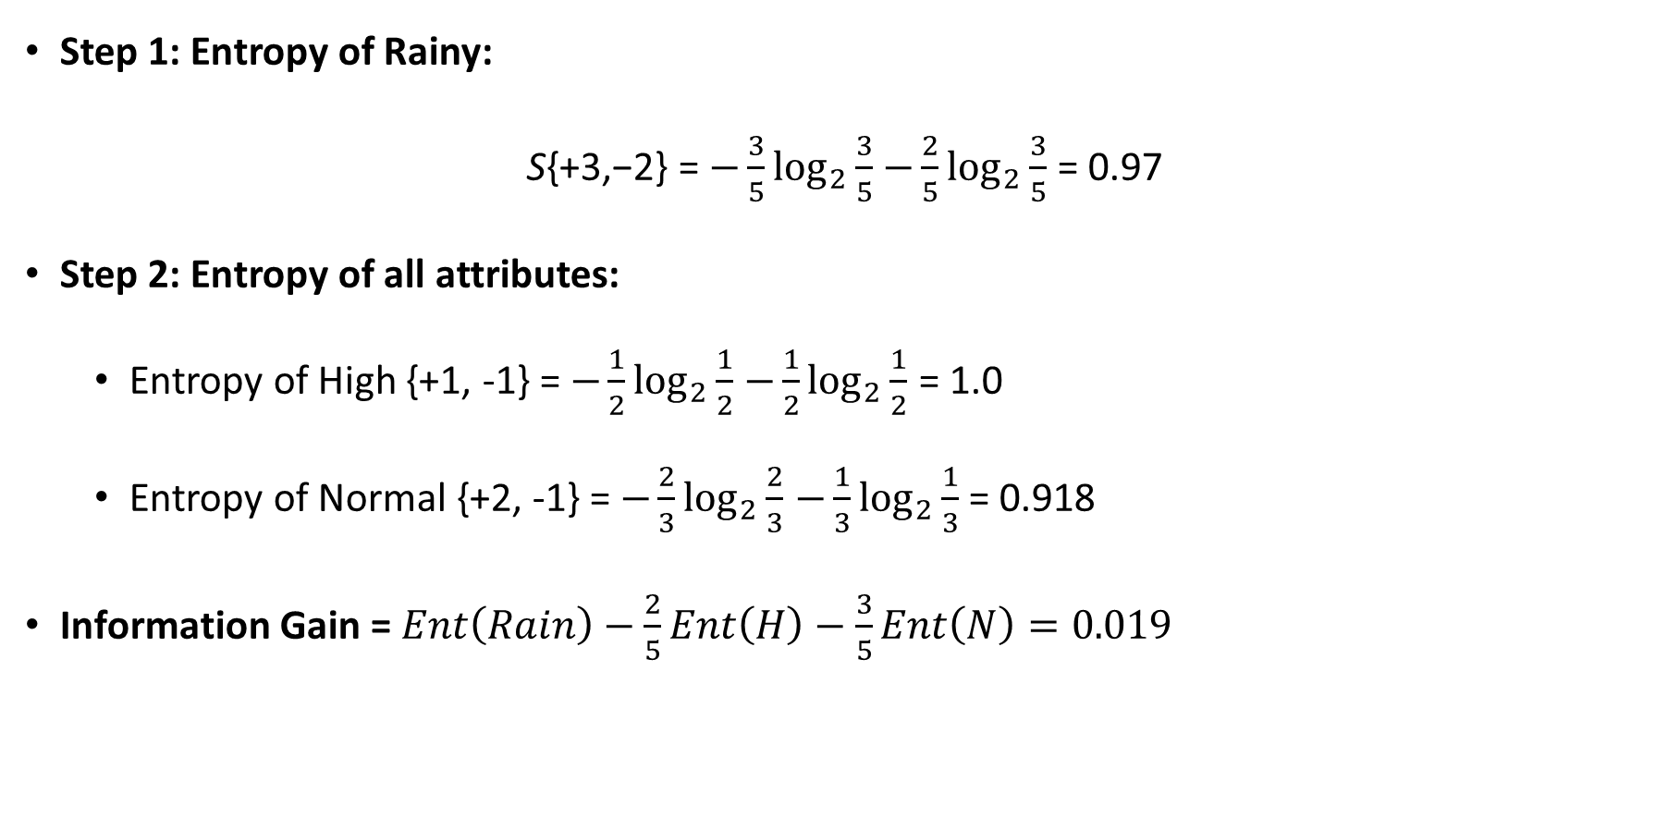
Calculate Information gain of Humidity
Step 1: Entropy of Rainy:
S{+3,−2} = $−\frac{3}{5}\log_{2}{\frac{3}{5}}$ $−\frac{2}{5}\log_{2}{\frac{3}{5}}$ = 0.97
Step 2: Entropy of all attributes:
Entropy of High {+1, -1} = $−\frac{1}{2}\log_{2}{\frac{1}{2}}$ $−\frac{1}{2}\log_{2}{\frac{1}{2}}$ = 1.0
Entropy of Normal {+2, -1} = $−\frac{2}{3}\log_{2}{\frac{2}{3}}$ $−\frac{1}{3}\log_{2}{\frac{1}{3}}$ = 0.918
Information Gain = $Ent\left(Rain\right)−\frac{2}{5}Ent\left(H\right)−\frac{3}{5}Ent\left(N\right)=0.019$

Slide 15
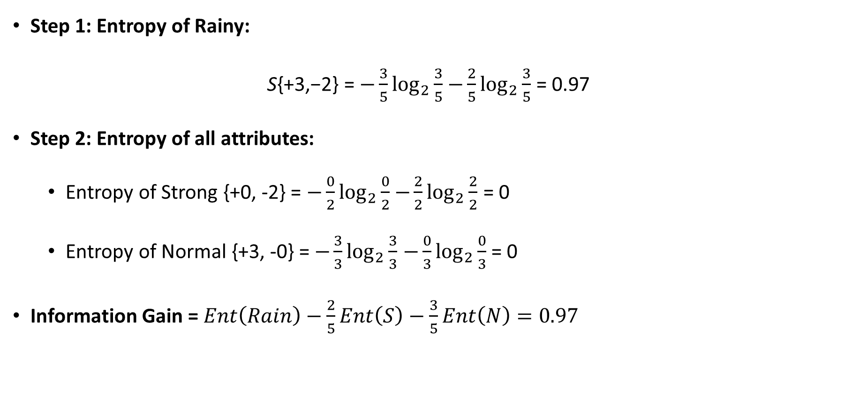
Calculate Information gain of Wind
Step 1: Entropy of Rainy:
S{+3,−2} = $−\frac{3}{5}\log_{2}{\frac{3}{5}}$ $−\frac{2}{5}\log_{2}{\frac{3}{5}}$ = 0.97
Step 2: Entropy of all attributes:
Entropy of Strong {+0, -2} = $−\frac{0}{2}\log_{2}{\frac{0}{2}}$ $−\frac{2}{2}\log_{2}{\frac{2}{2}}$ = 0
Entropy of Normal {+3, -0} = $−\frac{3}{3}\log_{2}{\frac{3}{3}}$ $−\frac{0}{3}\log_{2}{\frac{0}{3}}$ = 0
Information Gain = $Ent\left(Rain\right)−\frac{2}{5}Ent\left(S\right)−\frac{3}{5}Ent\left(N\right)=0.97$

Slide 16

Gain ($S_{rain}$, Temp) = 0.019
Gain ($S_{rain}$, Humidity) = 0.019
Gain ($S_{rain}$, Wind) = 0.97
Weather
Sunny
Cloudy
Rainy
Humidity
YES
Wind
Normal
High
Weak
Strong
YES
NO
YES
NO

